Slide 1
OER Video Data Management
Tools and Metadata
Susan Gottfried
OER Data Management
VDMMI Team

Slide 2
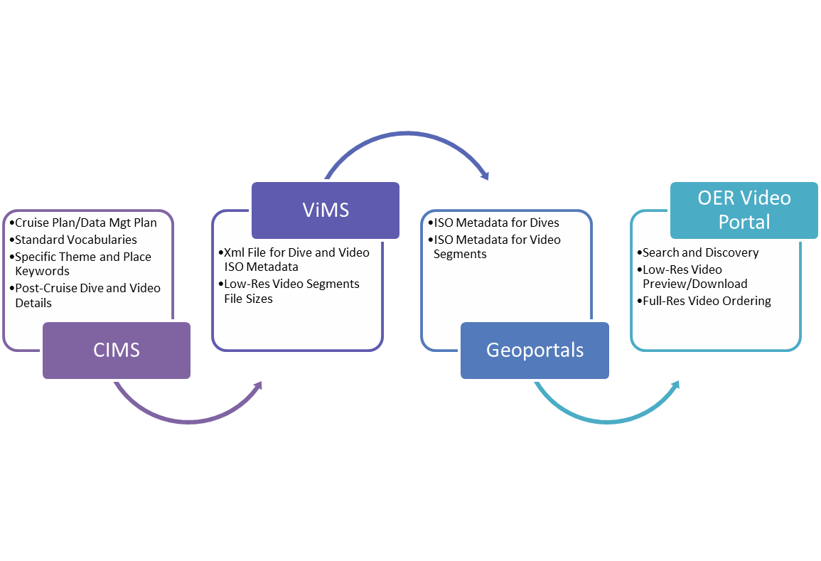
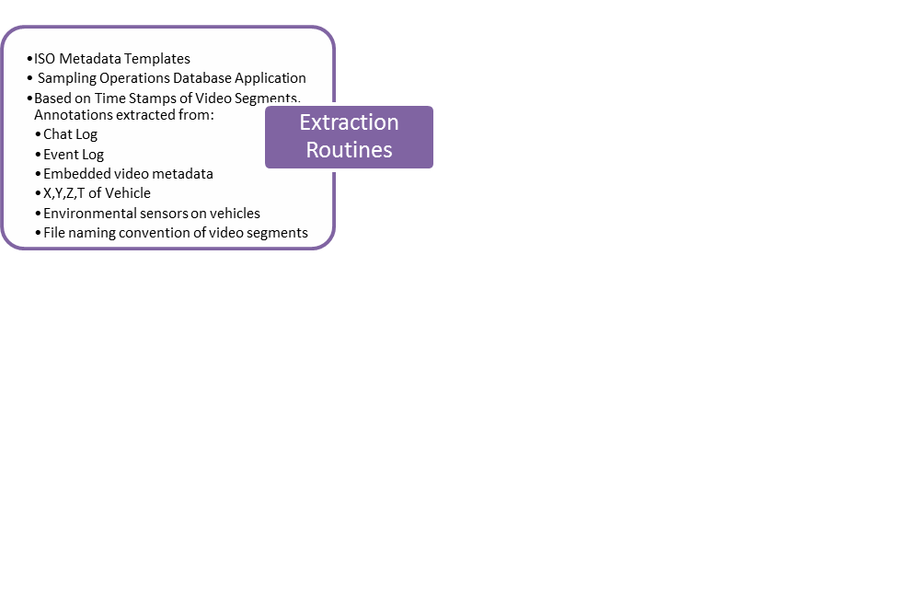
Tools and Information Flow for VDMMI
Publish cruise metadata
data.gov
Publish dive metadata

Slide 3
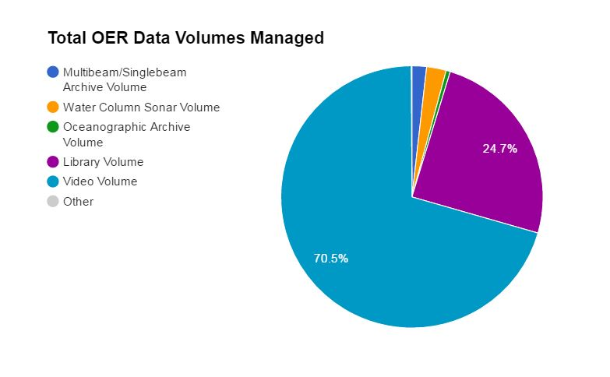
Metrics
Notes:
Until the Okeanos Explorer, most video was received on physical media and was catalogued and maintained in climate control storage at the NOAA Central Library. In order to view, scientists would need to use the NCL video lab.
Over time, tapes have become unstable

Slide 4
Metadata Hierarchy
Cruise Collection Metadata Record
Multibeam Collection Metadata Record
Oceanographic Collection Metadata Record
Dive Collection Metadata Record
NOAA Central Library Collection Metadata Record
MB File Level (level-0, level-1) Metadata Record
Granular Video Data (segs, streams, hi-lites) Metadata Records
NOAA Central Library Institutional Repository for Documents/Pubs

Slide 5
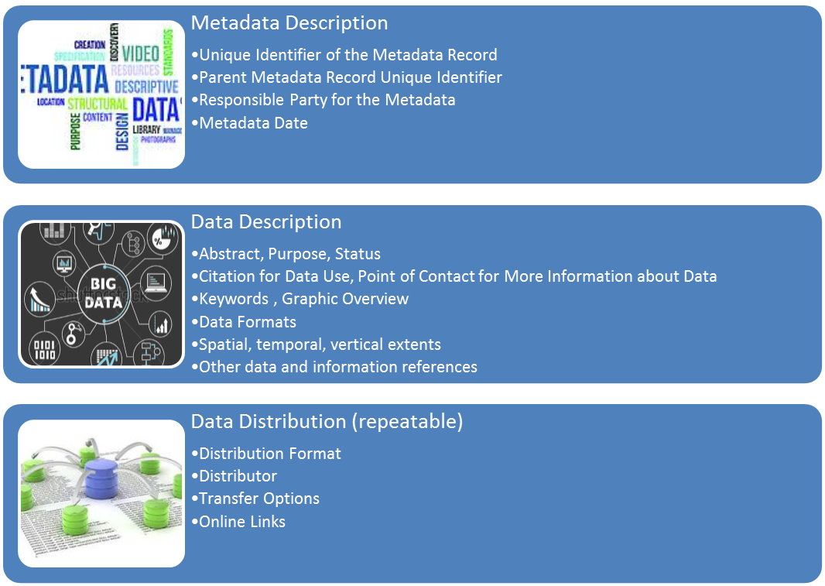
Metadata Construct

Slide 6
Inspiration
“My interests are focused on video of gelatinous zooplankton in the benthic boundary realm, especially at depths greater than 1000 m. Any environmental data obtained by the ROV would be useful to support studies of behavior (swimming, feeding, breeding, predator avoidance, dispersal)
and ecology (presence, distribution,
abundance).”
Marsh Youngbluth – January 2012

Slide 7
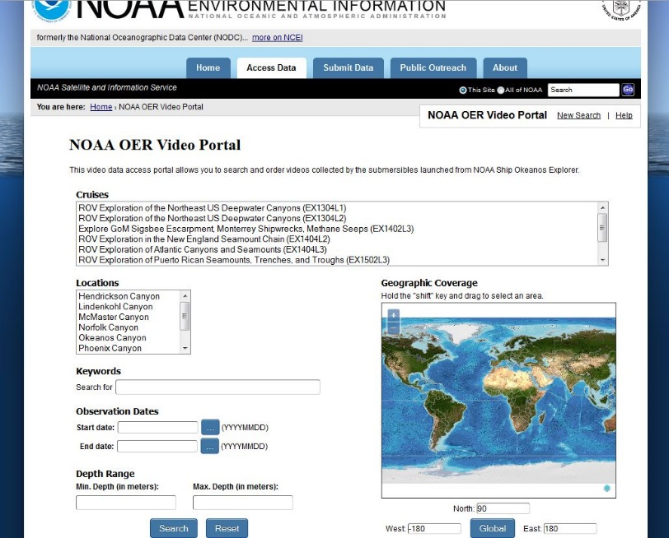
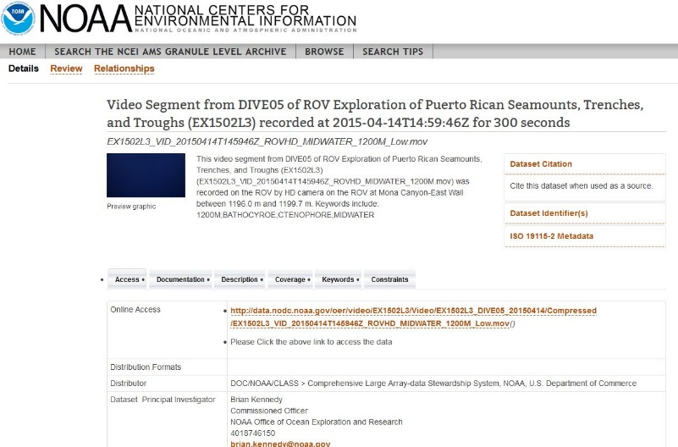
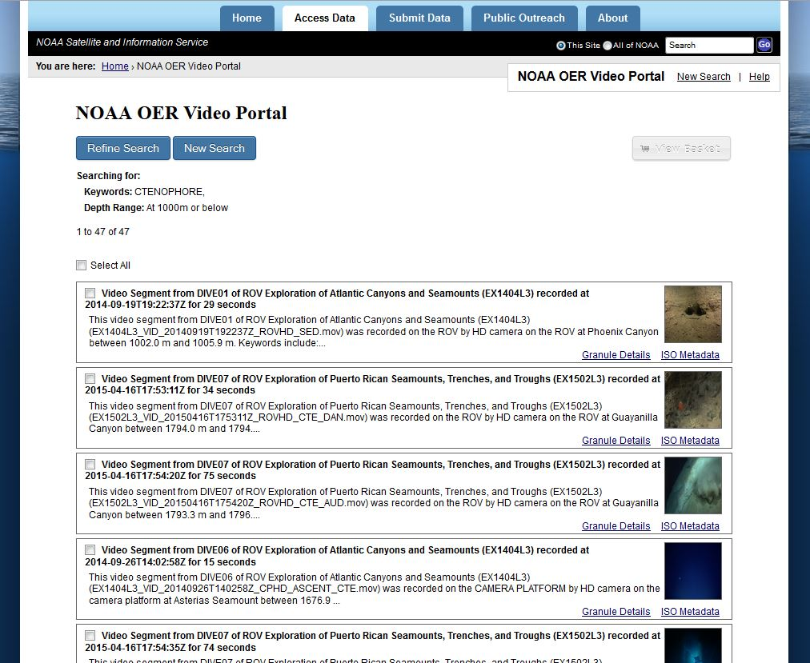
OER Video Portal (due June 30, 2016)

Slide 8
OER Video Portal (due June 30, 2016)
Demonstration of NCEI / OER Video Data Portal
https://test.nodc.noaa.gov/vgondle/oer/index.html

